Slide 1
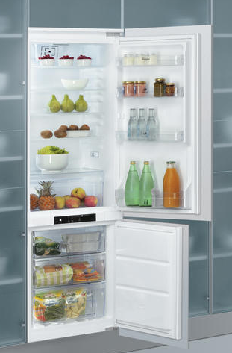

COOLING
BOTTOM MOUNT
MODEL NUMBER | ART 871/A+/NF
12NC | 856479015010
EAN code | 8003437039768
Total gross capacity (Lt.) | 282 L
Star Rating | 4
Climate class | SN-T
Type of control | Electronic
Frost free system | No Frost in the freezer
Energy class | A+
Color | White
REFRIGERATOR FEATURES
Antibacterial Filter | Yes
Air ventilation | Fan
Number of shelves in fridge compartment | 5 (4 adjustable)
Material of the shelves | Glass
Number of crisper drawers | 1
Led lighting | Starlight
Fast Cooling | Yes
FREEZER FEATURES
Number of freezing drawers | 3
ELECTRICAL FEATURES & DIMENSIONS
Product Dimension HxWxD cm | 177 X 54 X 54,5
Packed Product dimensions HxWxD cm | 183x59x60
Net Weight kg | 58 kg
Gross Weight kg | 62 kg
Max Electric power W | 160 W
Absorbtion A | 16
Voltage V | 220-240
Frequency Hz | 50
Type of Gas | R600a
IFU Language | EN, FR, AR
Plug type | UK

